Slide 1


Indoor
Air Pollution

Slide 2
Team: MR VR
Mentor: Prof. Sachin Chaudhari
TA: Rishikesh Bosh
Team Members:
Mayank Shukla
Rishabh Srivastava
Vaibhav Singh Tomar
Rishabh Jain

Slide 3


Introduction and Motivation
During Covid-19, We’ve kept ourselves safe and healthy by careful protection yet without effective information. Now it’s time to be out of the woods and learn indoor air quality solution.
People spend 90% of their time indoors and so the health problems that result from exposure to indoor pollution
increases, the contaminants in indoor air could damage people’s health.

Slide 4

Deployment Strategy
During deployment, We’ve looked at many places, Our main focus was wide-ranging data, which can be collected at real time and a the same time the place of deployment should be easily accessible.
Turned out that the best place, where wide-ranging data can be collected easily was Kadambh mess, so we deployed our prototype there.
Some other factor we looked into:-
Location from window Power supply
Specific height for easy reach
Proper internet connectivity

Slide 5
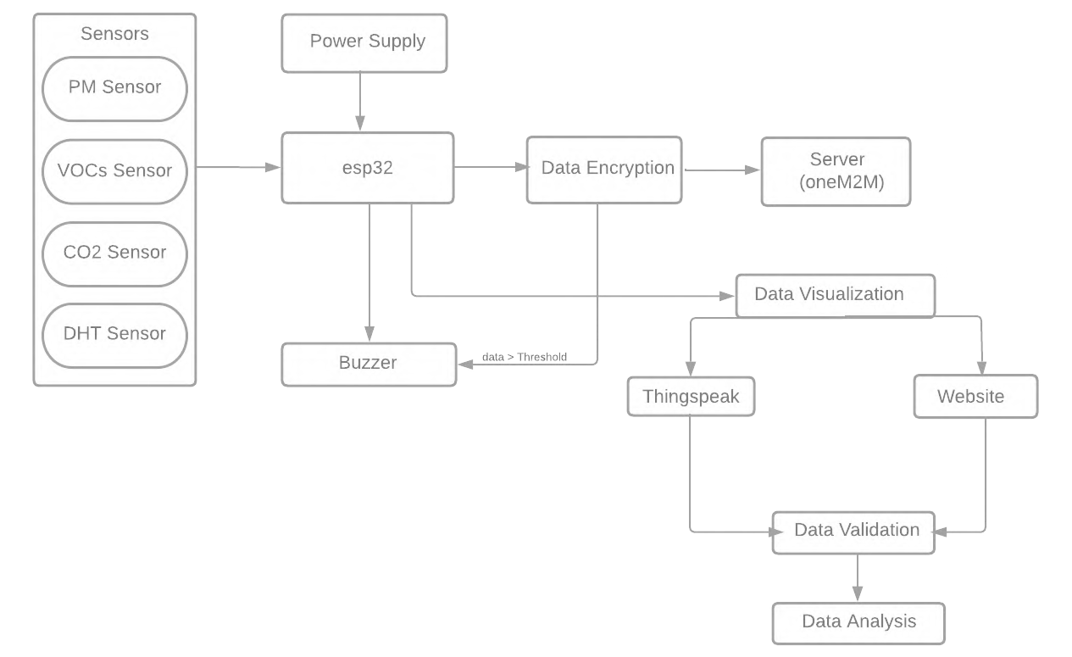
Workflow Block-Diagram

Slide 6
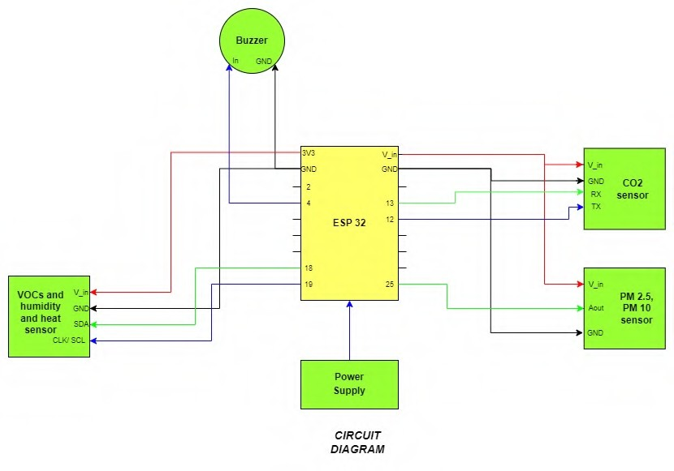

Hardware setup

Slide 7
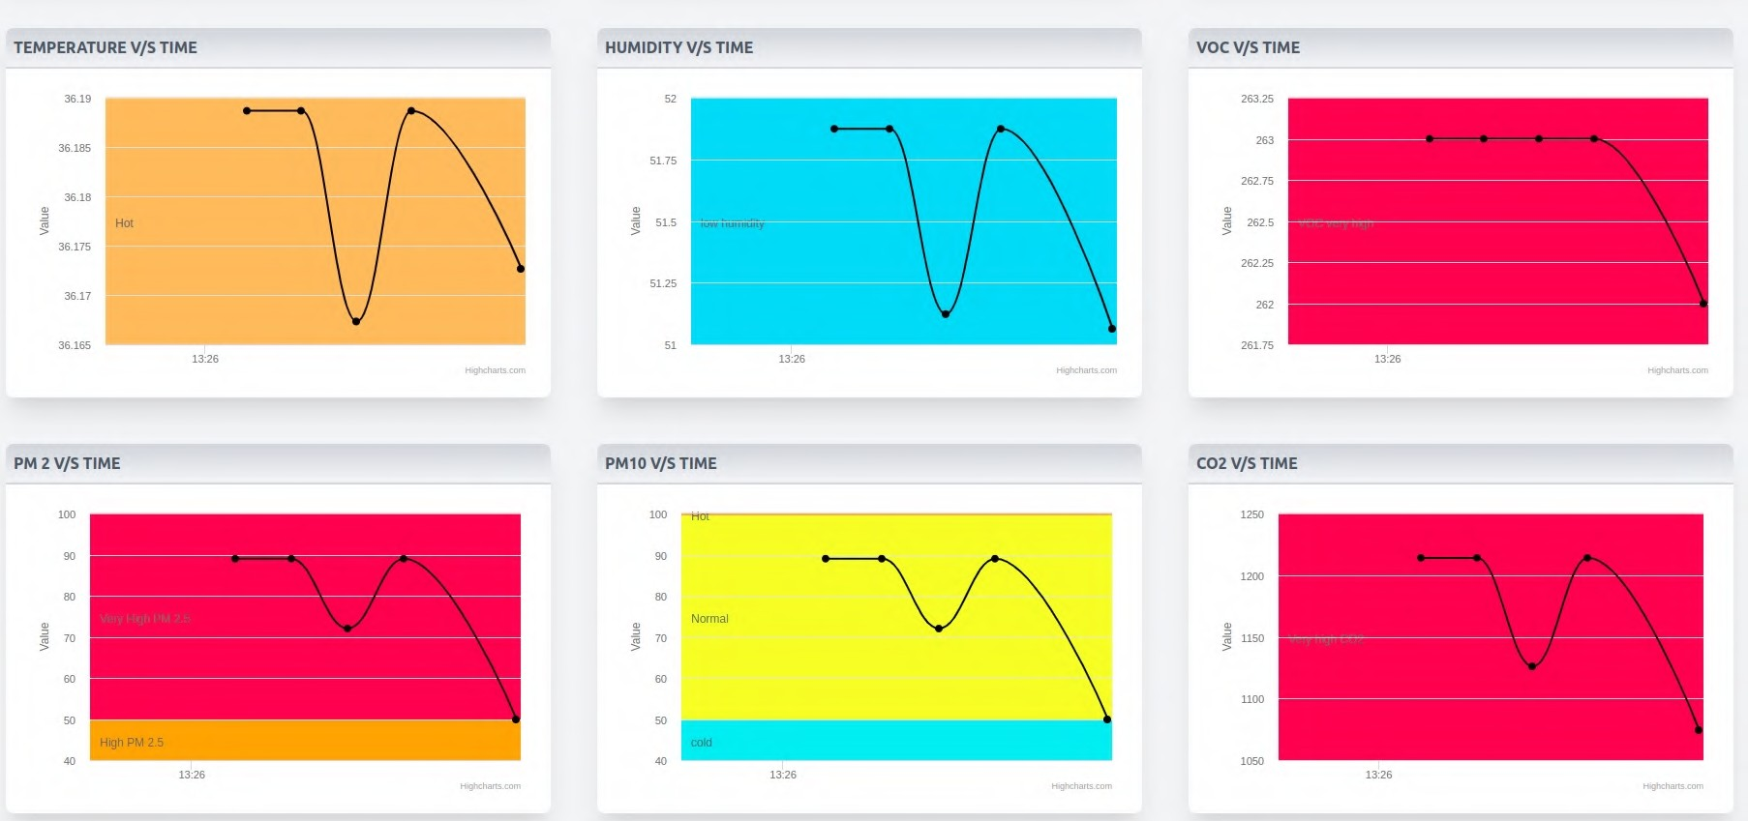
Website Features
Website will contain values of
Temperature Humidity VOC
Co2
Particulate Matter
•
•
•
In addition to that, website will also contain graphs, showing change in the values in each field.
I contains time filter which filter the data between certain range.

Slide 8
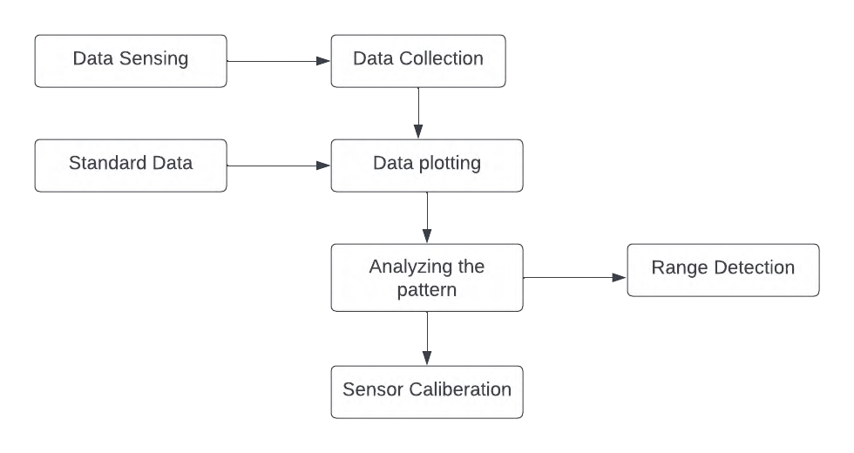
Data-Validation Pipeline

Slide 9
Data Security Data is encrypted before sending it to oneM2M using ECC algorithm. Also digital signature is implemented which will authenticate the data.
Reason behind using the ECC:
Since sensor nodes are resource limited we have to use such algorithm which do not consume much space i.e. space efficient algorithm.
It should provide security to data which maintains data security by keep data confedential, maintains data integrity, authentic and maintains data repudiation.
Since ECC gives same level of security with only 256 bits which RSA takes 3072 bits to achieve that, which shows that ECC is resource efficient.

Slide 10

Data Analysis
An analysis was done on the 7 data collected from kadamb mess. Data analysis was done in three parts:
Data Cleaning, that is removal of bad data from our dataset. The most common reason for bad data was irregularities in wifi and power connections.
Outlier Detection and Removal: This was done by two strategies iqr and z-score and the points which was regarded as outliers by both strategies were removed.
Inferences:
We can clearly state most rush day in the messes was on sunday and wednesday as on these days non-veg are served and mostly people have lunch there.
During cooking hours we can observe high values of pm2.5 and pm10 due to use of flour for making chapat is. On 9th of september there was a heavy rainfall. It is also reflected in our sensors.
The temperature dropped by 2-2.5°C.
Humidity increased by 7-8% on 9th.
The CO2 level is increased rapidly by 1500 ppm, which corressponds with the wikipidea text:
Given that water vapor is rarely more than 3% of the atmosphere and only a fraction of that can turn into rain, and the PPM is slightly lower in rain-water than air, that's a pret y slow way of pulling CO2 from the atmosphere. what's more, as rain water evaporates, that CO2 is returned to the atmosphere.

Slide 11
Thank you

